Slide 1
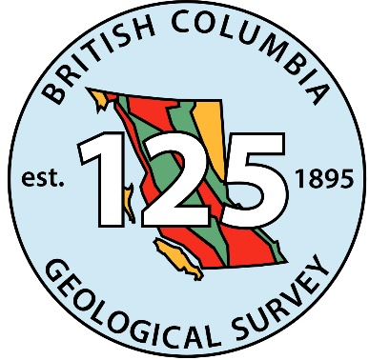
Mining and Exploration
British Columbia 2019
Gordon Clarke
BCGS Mineral Development Office
AME Roundup 2020

Slide 2
Outline
Mining Production
Exploration Expenditures
Mining and Exploration Highlights
British Columbia Geological Survey Activities
Summary

Slide 3
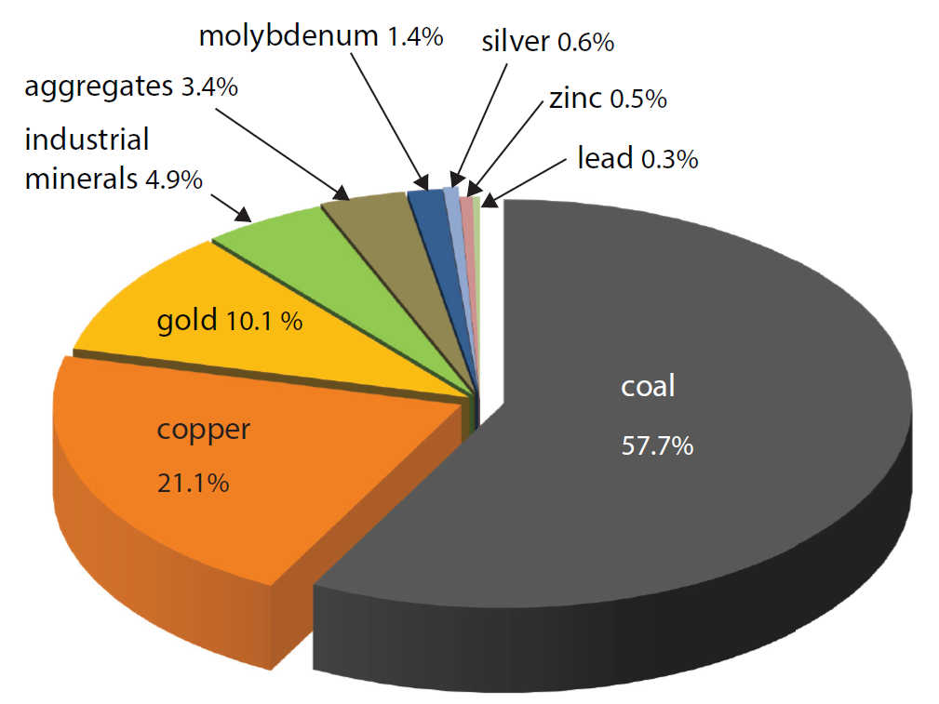
Mining Production 2019
Canada’s largest producer of copper and coal. Canada’s only producer of molybdenum.
Forecast $8.80 billion

Slide 4
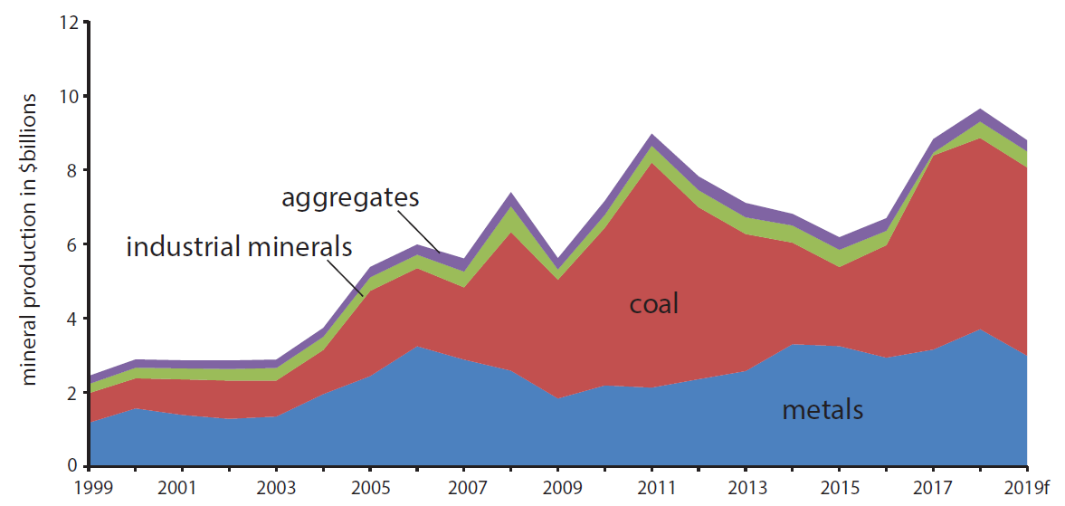
Mining Production 1998-2019
$8.80 Billion (forecast)
Decrease of $1.16 Billion vs 2019 preliminary estimate
Decrease primarily due to:
Lower HCC (hard coking coal) price

Slide 5
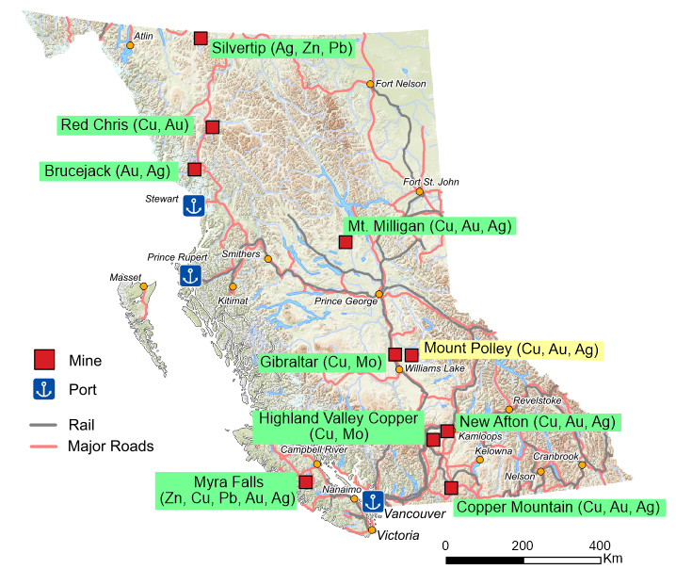
Current Metal Mines
Five open pit operations
Four underground operations (Silvertip, Brucejack, New Afton, Myra Falls)
Suspended operations in 2019
Mount Polley

Slide 6
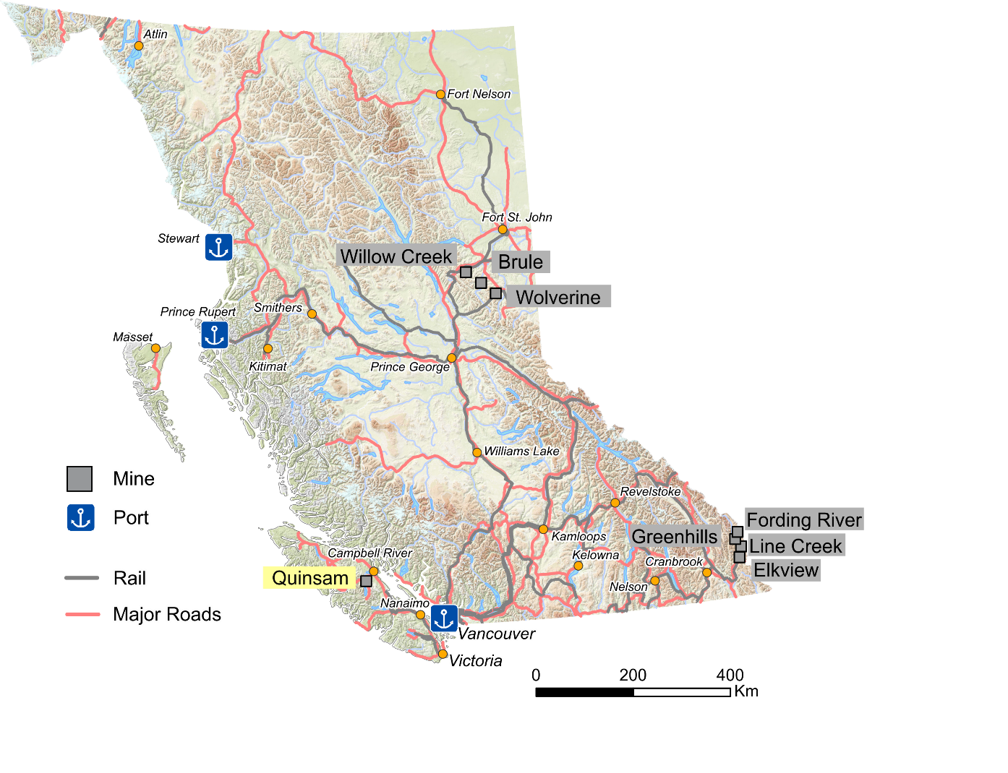
Current B.C. Coal Mines
Production is primarily metallurgical coal
Current
7 operating open pit mines
Suspended operation in 2019
Quinsam, underground (thermal coal)

Slide 7
Ernst &Young LLP 2019 Mineral and Coal Exploration Survey
Joint initiative between the Province of British Columbia, Ministry of Energy and Mines and Petroleum Resources, the Association for Mineral Exploration and EY LLP
Full report to be released at PDAC

Slide 8
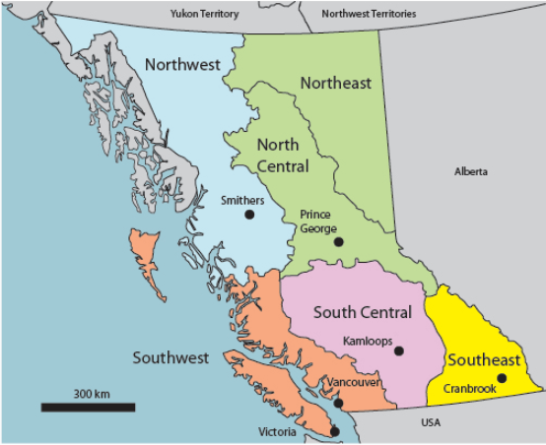
Regional Geologists
Five Regional Geologists in BC based in the regional offices (2 vacant positions)
One in the BCGS and 4 positions in the Health, Safety and Permitting branch
Recent hire Sean Tombe in Smithers
Recent retirement John DeGrace in Prince George
BCGS/MDO co-ordinates their geoscience outputs and publishes the annual Overview of Exploration and Mining in BC publication
BCGS/MDO also co-ordinates the Ernst & Young (EY) survey of BC mineral and coal exploration

Slide 9
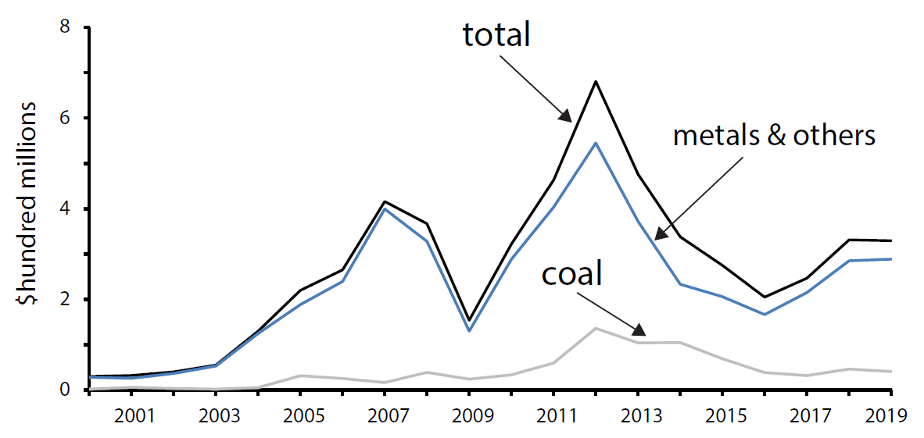
Exploration Expenditures
Total for 2019 $329.5 million
$288.7 million Metal + other
$40.8 million – Coal
Slight decrease ($1.9 million) vs 2018

Slide 10
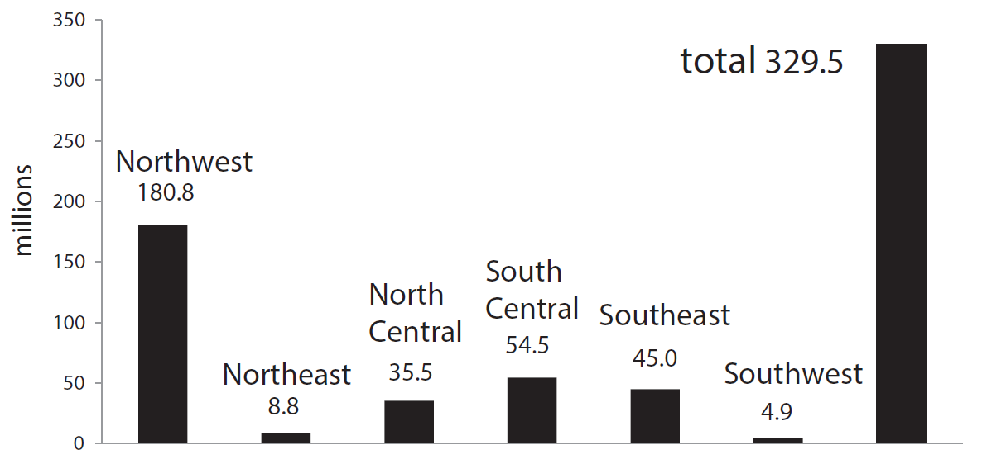
Exploration Expenditures by Region

Slide 11
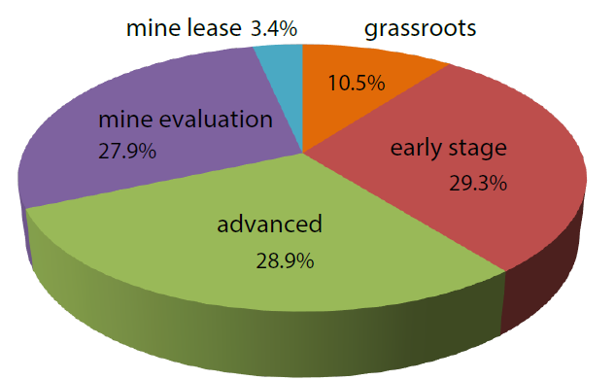
Exploration Expenditures by Category 2019

Slide 12
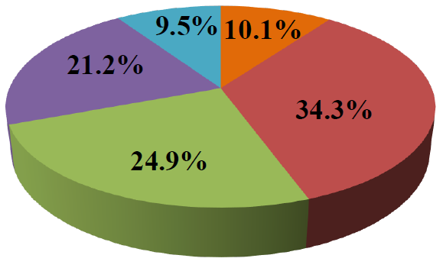
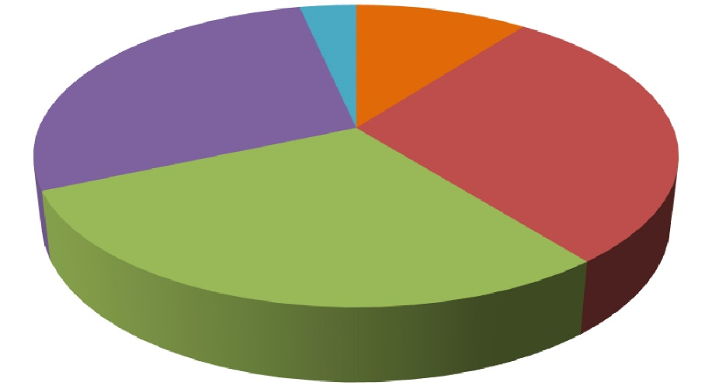
Exploration Expenditures by stage (2018 vs 2019)
3.4%
10.5%
27.9%
29.3%
28.9%
2018
2019
Combined grassroots and early stage decrease 39.8% vs 44.4%

Slide 13
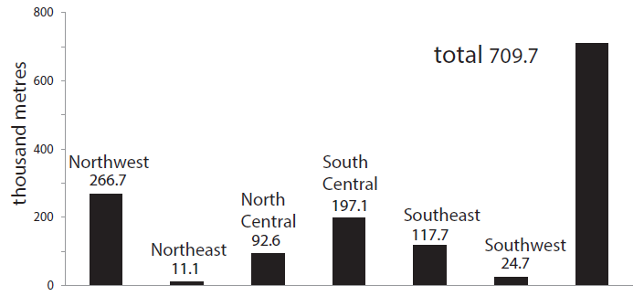
Exploration Drilling
709,700 m in 2019
Decrease of 20,800 m vs 2018

Slide 14
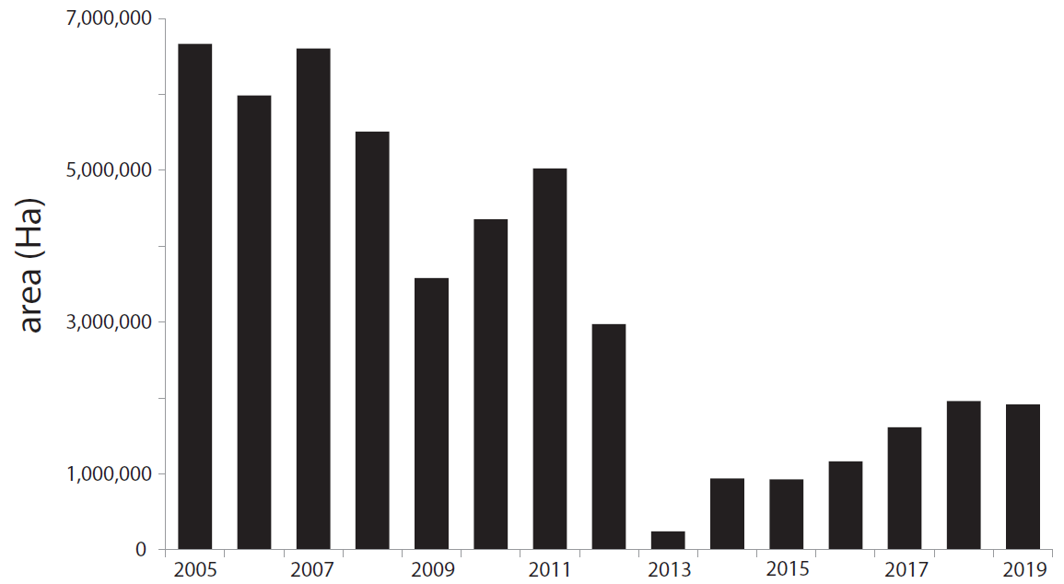
New Mineral Claims (ha)
2019 total 1,913,583 (ha)
Decrease of ~ 48,000 (ha) vs 2018
2013 total 246,156 (ha)

Slide 15
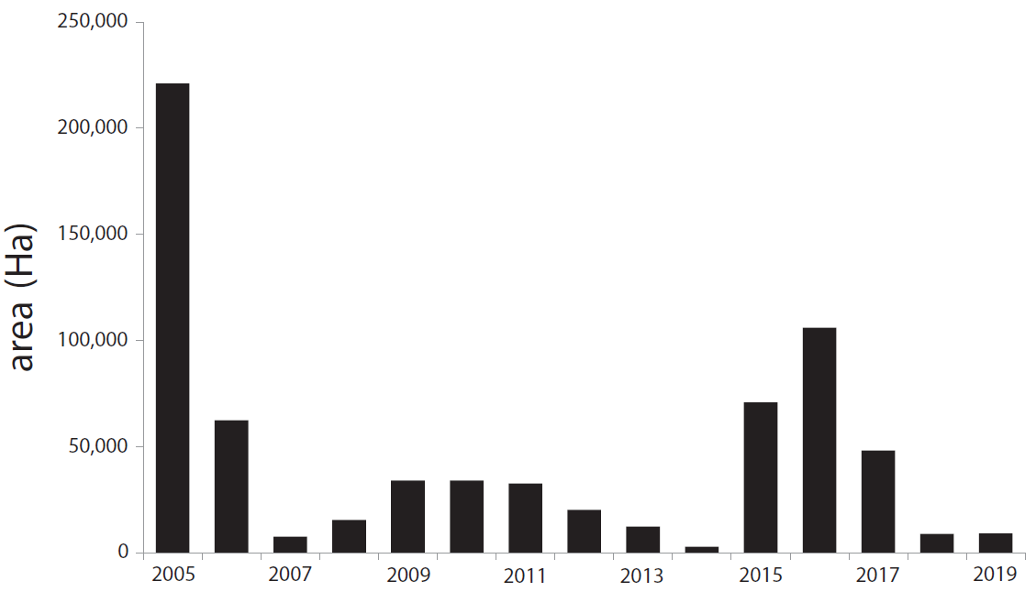
New Coal Licenses Issued (ha)
2019 Issued 9045 (ha)
2018 Issued 8,852 (ha)
2017 Issued 48,118 (ha)
2016 Issued 105,991 (ha)
2015 Issued 70,806 (ha)
2014 Issued 2,839 (ha)

Slide 16
2019 Industry Highlights
Mining
Mine development projects
Proposed Mines
Ongoing Exploration

Slide 17
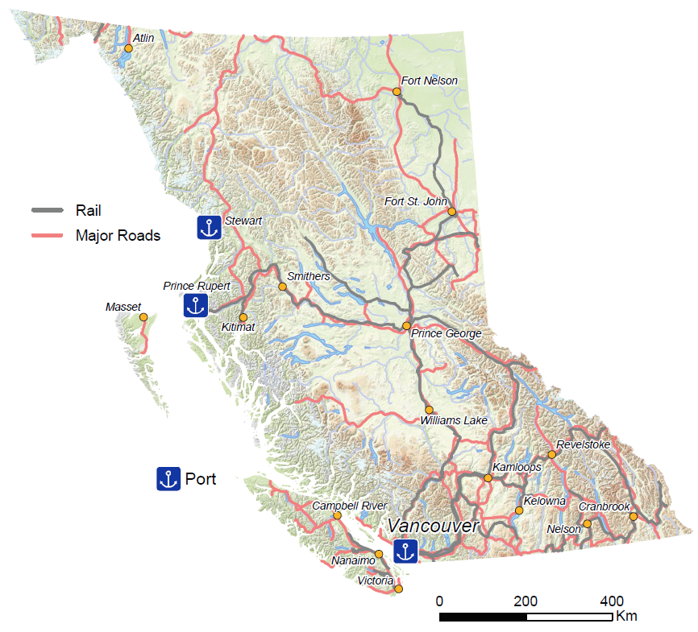
Mining Highlights
Silvertip (Ag, Zn, Pb)
Red Chris (Cu, Au, Ag)
Coeur Mining Inc. completed its first year of full production, carried out regional exploration and announced a mineral resource update for the Silvertip mine. M+I: 1.18 Mt at 222.73 g/t Ag, 4.09% Pb, 8.58% Zn. Reserves are P+Pr 1.61 Mt at 289 g/t Ag, 5.6% Pb, 8.24% Zn
Newcrest Mining Limited purchased a 70% interest in the Red Chris mine from Imperial Metals Corporation for US$804 million. P+Pr reserves of 301.5 Mt at 0.36% Cu, 0.27 g/t Au
Pretium Resources Inc. updated their mineral reserves and resources. P+Pr: 16 Mt grading 12.6 g/t Au and 59.3 g/t Ag. M+I: 18.7 Mt at 14.2 g/t Au and 81.6 g/t Ag
Brucejack (Au, Ag)

Slide 18
Mining Highlights (cont.)
Teck Resources Limited entered the EA process for a proposed extension of mine life to 2040 for Highland Valley Copper. The project is at the pre-feasibility stage. In May, Teck also obtained a Mines Act permit for a proposed extension of the former Bethlehem mine’s Jersey and Iona pits
Nyrstar N.V. restarted Myra Falls in April. Underground exploration continued with 17,000 m of drilling. P+Pr: 4.7 Mt at 7.11% Zn, 0.78% Pb, 0.92% Cu, 76.55 g/t Ag, 1.78 g/t Au
Copper Mountain Mining Corporation incorporated 2017-2018 drilling results and announced a new Reserve estimate. P+Pr 476.8 Mt at 0.23% Cu, 0.10 g/t Au, 0.73 g/t Ag. Expected mine life is now 31 years, based on current reserves and planned production level
Highland Valley Copper (Cu, Mo)
Myra Falls (Zn, Cu, Pb, Au, Ag)
Copper Mountain (Cu, Au, Ag)

Slide 19
Mine Development Projects
CertainTeed Gypsum Canada Inc. – Kootenay West
Gypsum deposit
Resource 16.9 Mt (average quality 83-85%)
Currently under construction
Production 400,000 tpy (43 year mine life)
Kootenay West (Gypsum)

Slide 20
Proposed Mine Highlights
Newmont Corporation purchased Novagold Resources Inc.’s 50% ownership of the Galore Creek project in 2018. Teck Resources Limited owns the remaining 50%. The joint venture was active this year and activities included new drilling. The project has P+Pr reserves of 528 Mt at 0.59% Cu, 0.32 g/t Au, 6.02 g/t Ag
Seabridge Gold Inc., focused on evaluating additional resource potential. The project has P+Pr reserves of 2.198 Bt at 0.21% Cu, 0.55 g/t Au, 2.6 g/t Ag and 0.00426% Mo
Ascot Resources Ltd. acquired the Red Mountain project from IDM Mining Ltd. in 2019 for $45 million and used 2018 drilling results for a new resource estimate. M+I resources of 3.19 Mt at 7.63 g/t Au and 21.02 g/t Ag
Galore Creek (Cu, Au, Ag)
KSM (Cu, Au, Ag, Mo)
Red Mountain (Au, Ag)

Slide 21
Proposed Mine Highlights (cont.)
Kutcho (Cu, Zn, Ag, Au)
Kutcho Copper Corp.’s Kutcho project entered the EA process in September. The deposit has Probable reserves of 10.4 Mt grading 2.01% Cu, 3.19% Zn, 0.37 g/t Au and 34.61 g/t Ag, with a M+I resource of 17.26 Mt at 1.85% Cu, 2.72% Zn, 0.49 g/t Au, and 33.9 g/t Ag
HD Mining International Ltd., has its Provincial and Federal EAC’s and its Mines Act permit for the proposed Murray River coal mine. A final investment decision is required by HD’s parent company China Huiyong Holdings. The project has Proven reserves of 261 Mt mineable coal
New Gold Inc., received both provincial and federal EA certificates for their Blackwater project. A time line for application for a mines act permit has not been announced. The project has P+Pr reserves of 344.4 Mt at 0.74 g/t Au, 5.5 g/t Ag
Murray River
(Coal)
Blackwater (Au, Ag)

Slide 22
Proposed Mine Highlights (cont.)
Conuma Resources Limited applied to the EA office for an amendment to open pit mine the Herman deposit as a satellite operation of the Wolverine mine. It would produce 1.5 to 3 Mt of coal per year and add up to 7 years to the life of the wash plant at Wolverine
Telkwa Coal Ltd. continued to work on their Tenas coal project. Itochu Corp. has a 5% interest. The project has P+Pr reserves of 62.9 Mt of coal
The Ruddock Creek project is a joint venture with Imperial Metals Corporation (45.3%), Mitsui Mining and Smelting Co. Ltd. (30%) and Itochu Corporation (20%), Japan Oil, Gas and Metals National Corporation (4.7%). JOGMEC has earned their interest by funding a drilling program for the second year in a row. 2019 drilling highlights included 40.9 m grading 16.83% Zn, 3.46% Pb and 4.74 g/t Ag. The project has M+I resources of 6.25 Mt at 6.5% Zn, 1.33% Pb
Wolverine-Herman
(Coal)
Tenas (Coal)
Ruddock Creek (Zn, Pb)

Slide 23
Proposed Mine Highlights (cont.)
Barkerville Gold Mines Ltd. released a PEA for their Cariboo Gold project. Proposed 4000 tpd underground operation. Reserves of 14.7 Mt at 4.5 g/t Au average diluted gold grade would give an expected 11-year mine life. A large (91,000 m) drilling program continued into late fall. In November, Osisko Gold Royalties Ltd. acquired all shares in Barkerville Gold Mines Ltd. they did not already own. The deal valued Barkerville at about $338 million
The Crown Mountain project is owned by NWP Coal Canada Ltd., 80% (a wholly owned subsidiary of Jameson Resources Ltd.) and Bathurst Resources Limited, 20%. Bathurst can earn another 30%. In 2019 coal quality test work results were released indicating 84% of the coal is hard coking coal, the remainder PCI coal. A feasibility study is in progress
In 2019 North Coal Ltd., continued environmental baseline, permitting, and mine design for its Michel Coal project
Cariboo Gold (Au)
Crown Mountain
(Coal)
Michel Coal

Slide 24
Ongoing Exploration highlights
Brixton Metals Corporation carried out a 2,000 km helicopter-borne magnetic survey and drilled 1,600 m at their Atlin Gold project. Drill results included 2 m grading 8.53 g/t Au
Brixton also drilled at their Thorn projects Oban zone. Results included 554 m of 0.57 g/t Au, 0.24% Cu, 43 g/t Ag, 0.55% Zn, and 0.28% Pb
Golden Ridge Resources Ltd. drilled 2,952 m at their Hank project. Results included 278 m grading 0.35% Cu, 0.28 g/t Au and 1.71 g/t Ag
A 9,900 m drilling program was carried out at the Treaty Creek project (Tudor Gold Corp. 60%; Teuton Resources Corp. 20%; American Creek Resources Ltd. 20%). Results included 2.006 g/t Au across 87 m, within 336 m averaging 1.004 g/t Au
Atlin Gold (Au)
Thorn (Cu, Au, Ag, Zn, Pb)
Hank (Cu, Au, Ag)
Treaty Creek (Au)

Slide 25
Ongoing Exploration highlights (cont.)
Turnagain (Ni, Co)
Giga Metals Corporation used 2018 drilling results to update the mineral resource for their Turnagain project. M+I: 1.073 Bt at 0.220% Ni and 0.013% Co. Inf: 1.142 Bt at 0.217% Ni and 0.013% Co
GT Gold Corp. continued to advance exploration at their Tatogga project’s Saddle North target. Newmont Corporation invested $25.9 million. Over 25,000 m of drilling was carried out. Results included 324 m grading 0.43% Cu, 0.82 g/t Au and 1.76 g/t Ag, 685 m grading 0.44 % Cu, 0.70 g/t Au and 1.09 g/t Ag. A resource estimate is planned for Q2 2020 and a PEA by Q4 2020
StrikePoint Gold Inc. drilled the North Zone target at their Willoughby project. Results included 102 g/t Au and 356 g/t Ag over 1.0 m within 26.28 g/t Au and 95.00 g/t Ag over 4.0 m
Tatogga, Saddle North (Cu, Au, Ag)
Willoughby (Au, Ag)

Slide 26
Ongoing Exploration highlights (cont.)
Hochschild Mining Holdings Ltd. optioned the Snip project from Skeena Resources Limited late in 2018. In 2019 1,943 m of surface drilling was completed and intersected a drill highlight of 1,132 g/t Au across 1.5 m
At their Eskay Creek project, Skeena reported that highlight drill intersections included 312.81 g/t Au and 95 g/t Ag across 2.21 m and 6.75 g/t Au and 285 g/t Ag across 27.50 m. New mineral resouce numbers were released: Pit constrained - Indicated 12.65 Mt at 4.3 g/t Au, 110 g/t Ag, Inferred 4.42 Mt at 2.3 g/t Au, and 47 g/t Ag Underground - Indicated 819,000 t at 6.4 g/t Au and 139 g/t Ag, Inferred 295,000 t at 7.1 g/t Au and 82 g/t Ag
Pretium Resources Inc. carried out a 15,000 m drilling program on multiple regional prospects. Highlights from the A6 zone included 1.5 m grading 2,890 g/t Ag and 1.81% Cu
Snip and Eskay Creek (Au, Ag)
Brucejack Regional (Au, Cu, Pb, Zn)

Slide 27
Ongoing Exploration highlights (cont.)
Garibaldi Resources Corp. continued to explore known mineralization at depth and along strike at their Nickel Mountain project. Approximately 25,000 m of diamond drilling was carried out. Highlights included 18.2 m grading 7.04% Ni, and 3.81% Cu in a broader zone of mineralization of 86.5 m grading 1.88% Ni and 1.32% Cu
Ascot Resources Ltd., carried out programs at their adjacent Premier and Silver Coin projects. At Premier over 52,000 m of diamond drilling was completed. Highlights included 24.45 g/t Au across 8.43 m. Last week, new resource numbers were announced. Total indicated 4.1 Mt at 8.01 g/t Au, 35.1 g/t Ag. Total inferred 5.06 Mt at 7.25 g/t Au, 28.7 g/t Ag
At the Silver Coin project an 11,000 m diamond drilling program was completed. Drilling highlights included 52.67 g/t Au across 3.59 m and 30.81 g/t Au across 6.69 m
Nickel Mountain (Ni, Cu, Co)
Premier (Au, Ag)
Silver Coin (Au, Ag, Cu, Zn, Pb)

Slide 28
Ongoing Exploration (cont.)
Benchmark Metals Inc. drilled 11,000 m on their Lawyers project. Results included 4.4 m grading 11.73 g/t Au, 476 g/t Ag, 25.0 m grading 2.79 g/t Au, 177 g/t Ag and 2.87 m grading 46.9 g/t Au, 3056 g/t Ag
ZincX Resources Corp. drilled 2,347 m on their Akie project. Drilling was focused on the high grade core of the Cardiac Creek deposit. Results included 10.94 m (true width) of 10.85% Zn, 2.23% Pb and 17.0 g/t Ag and 14.65 m (true width) of 16.20% Zn, 3.39% Pb and 27 g/t Ag
Sun Metals Corp. drilled 15,000 m on their Stardust project. The 421 zone was discovered in 2018 and new 2019 results included 24.85 m of 3.13% Cu, 4.8 g/t Au and 93.45 g/t Ag, and 58.01 m of 2.49% Cu, 2.61 g/t Au and 44.3 g/t Ag
Work by Dolly Varden Silver Corporation on their Dolly Varden project included metallurgical testing and a 11,000 m drilling program. Highlight results included 15.20 m grading 488.3 g/t Ag, 0.55% Pb, and 0.05% Zn. Dolly Varden also released an updated mineral resource with total Indicated resources of 3.42 Mt grading 299.8 g/t Ag and an additional Inferred resource of 1.29 Mt grading 277.0 g/t Ag
Lawyers (Au, Ag, Cu, Zn)
Akie (Zn, Pb, Ag)
Stardust (Cu, Au, Ag, Zn)
Dolly Varden (Ag)

Slide 29
Ongoing Exploration highlights (cont.)
Colonial Coal International Corp. announced a PEA for an open-pit-only mine for its Huguenot project. M+I resources of 132.0 Mt. It would yield 72 Mt of product coal over a 27 year mine life
Defense Metals Corp. drilled 2,005 m and reported positive metallurgical results for a 30 t bulk sample collected late in 2018. Drilling results included 4.43% LREO across 83 m; including 5.47% LREO across 33 m
Westhaven Ventures Inc. drilled approximately 20,000 m at their Shovelnose project. Drilling has now defined three gold-bearing vein zones. Drilling results included 12.66 m grading 39.31 g/t Au and 133.11 g/t Ag
Wicheeda (REE)
Huguenot (coal)
Shovelnose (Au, Ag)

Slide 30
Ongoing Exploration highlights (cont.)
Magnum Goldcorp Inc. carried out a small diamond drilling program (250 m) at its LH project. Highlight results included 6.34 m grading 5.15 g/t Au and 10.92 m grading 2.01 g/t Au
ArcWest Exploration Inc. sampled up to 21.2 g/t Au and 15 g/t Ag in an apparent epithermal zone at their Teeta Creek project, primarily known as a porphyry Cu-Mo prospect. Teck Resources Limited has entered into an agreement to explore the property to earn an initial 60%
LH (Cu, Ag, Au)
Teeta Creek
(Cu, Mo, Au)

Slide 31
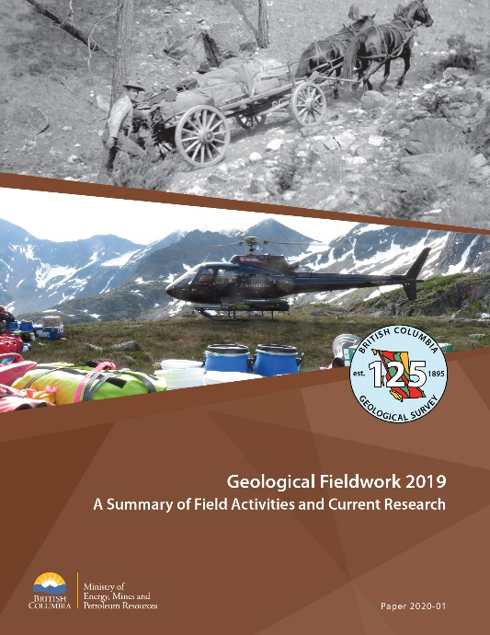
British Columbia Geological Survey
Deposits studies and exploration methods
Specialty metals (REE, Nb, Ta)
MVT and carbonatite geochemistry
Cost effective heavy mineral exploration methodology
Age constraints on the Wolf deposit, Kitsault area
CO₂ sequestration and awaruite (Ni) potential in the Decar area
Regional mapping and compilation
Bedrock and surficial geology of the northern Hogem batholith
Geology and stratigraphy of the Kitsault area
Southern Nicola arc compilation and stratigraphy
Compilation of NW BC geology (GEM 2)
Databases
Data models for geochemical and geochronological databases at the BC Geological Survey

Slide 32
Assessment reports and digital data submission
BCGS has embarked on a program to encourage submission of digital data files such as spreadsheets, databases, maps, and grids
Files can be:
  uploaded through the ARIS Data Submission page (http://ardata.bcgeologicalsurvey.ca)
  submitted by CD/DVD/USB when an assessment report is filed
  or e-mailed to ARIS.digital@gov.bc.ca
For more details Gabe Fortin will be presenting at the Innovation Stage at 3:30 on Tuesday

Slide 33
Summary
Continued investment in operating mines and advanced projects
Exploration expenditures stable over the last year
New projects have moved into the proposed mine category
Drilling programs continue to produce excellent results

Slide 34
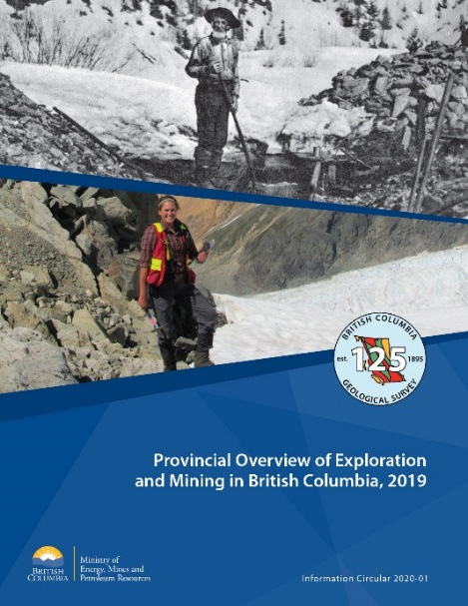
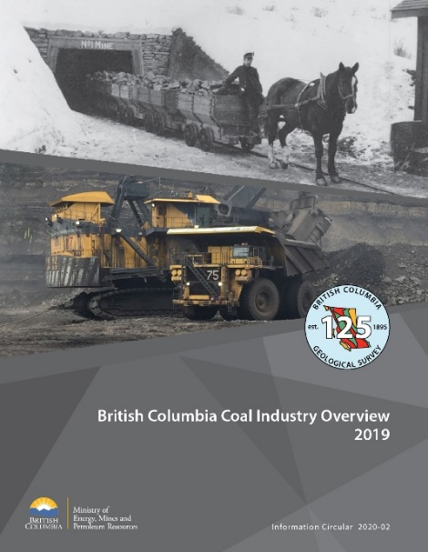

New publications are now available
  Please visit our booth #617 or go on-line at: https://www2.gov.bc.ca/gov/content/industry/mineral-exploration-mining/british-columbia-geological-survey/publications

